Slide 1


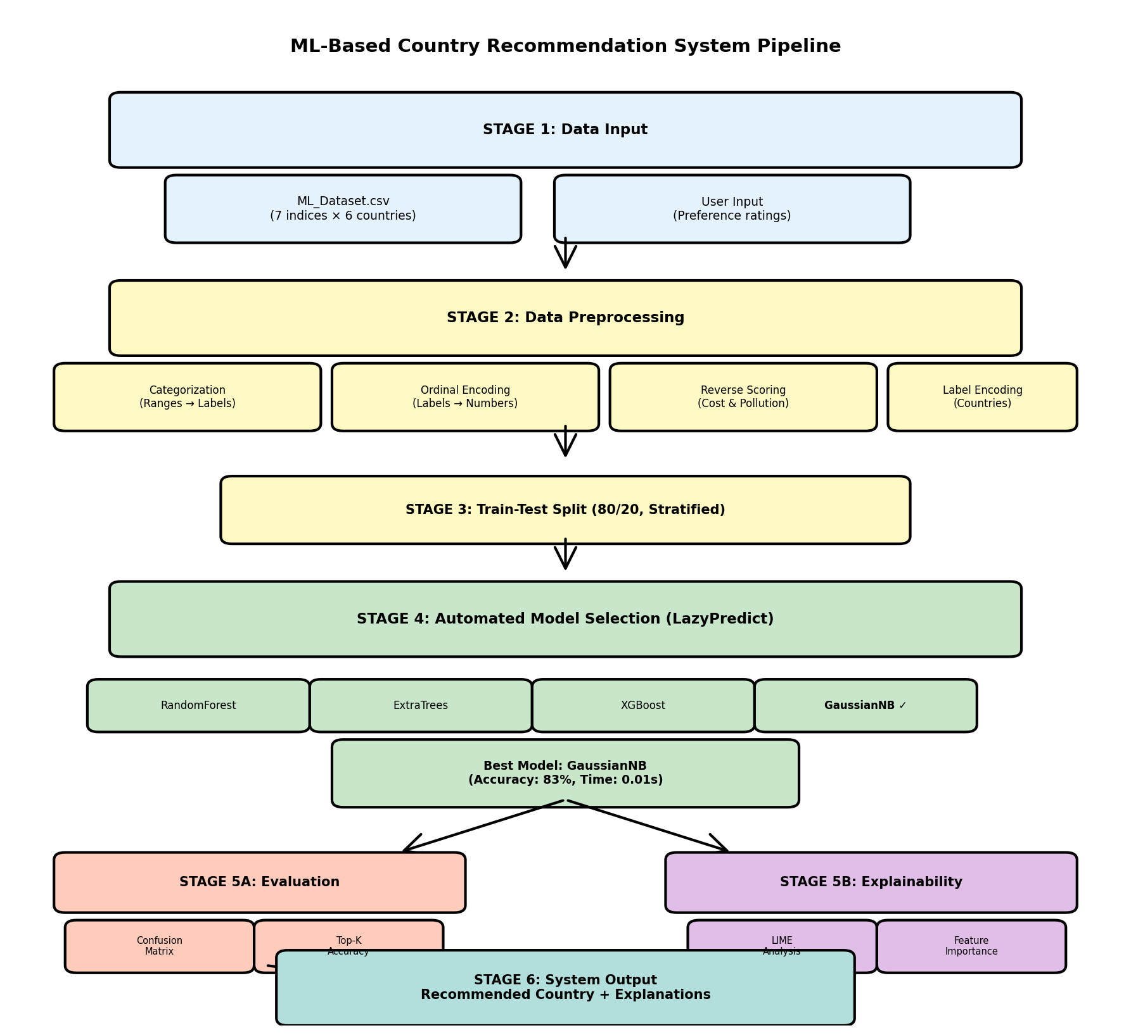
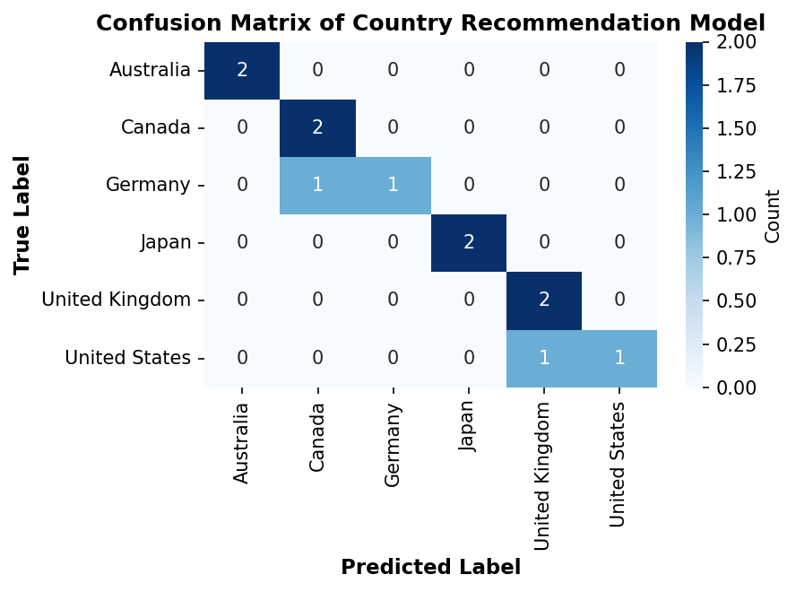
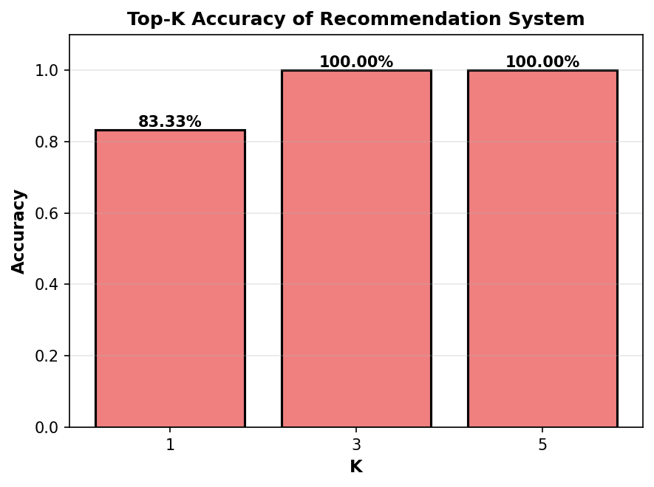
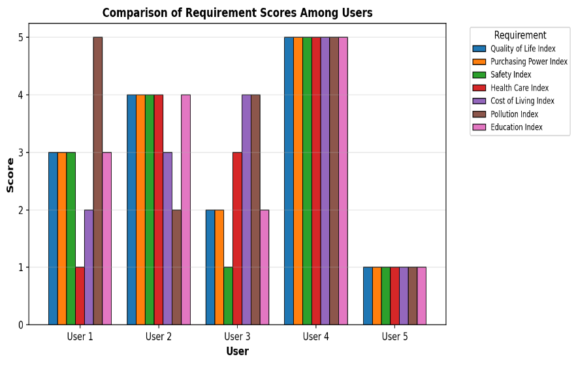
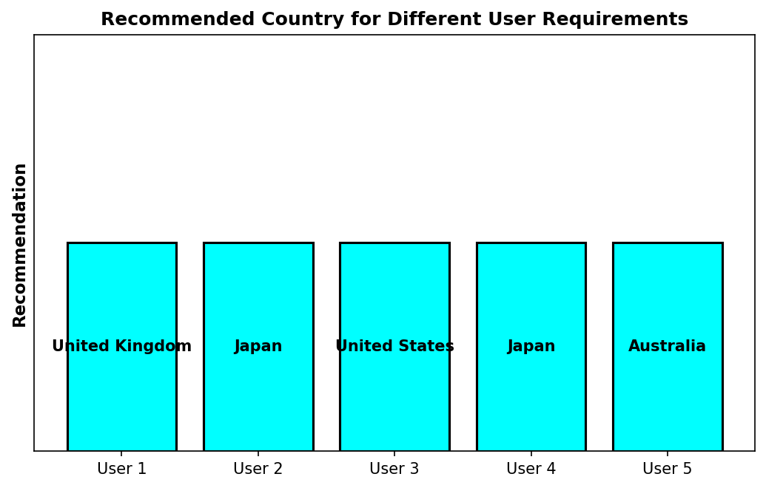

Paper ID: 4811
Paper Title: Machine Learning Based Multi-Criteria Evaluation of Six Developed Countries for Mobility Decision
Authors’ Name: Hasibul Islam¹, Abida Afrin², Tasfia Tofail³, Sharfuddin Mahmood⁴
Abstract & Introduction
Methodology
Conclusion & Future Work
In recent years, the global movement of people moving for educational and employment reasons has increased considerably. Finding the best country to go to for either of these reasons is a multimodal decision-making process based on many socio-economic criteria, such as the quality of life, safety, access to health care services, the cost of living, the pollution level, the purchasing power compared with your actual income and the education system available in each country. Most traditional methods of making these types of decisions are based largely on qualitative/subjective criteria in their weighting allocations and can produce unequal or bias-based results.
The purpose of this study is to present a Machine Learning-Based Multi-Criteria Evaluation System (ML-MCES) that can objectively find countries to go to for both educational and employment purposes. In order to accomplish this, the ML-MCES was applied to six of the industrialized countries in the world (the United States, Canada, United Kingdom, Germany, Australia, and Japan) using seven different socio-economic characteristics to evaluate each country. The ML-MCES uses automated selection of models, combined with Explainable AI methods, in order to make recommendations that are both objective and transparent in nature.
• Data sourced from around the world (2025).
• Seven socio-economic indicators have been converted to ordinal
categorical levels.
• Ordinal Encoding and Label Encoding methods were applied.
• 80/20 stratified sampling was used for splitting the dataset.
• Multiple classifiers were evaluated through Lazy Predict.
• The best classifier was chosen: Gaussian Naive Bayes.
• Performance metrics included Accuracy, Precision, Recall & F1-Score.
• The quality of recommendation was measured in Top-K Accuracy.
• Explainability was implemented using LIME.
This study provides a strong Machine Learning (ML) based Multi-Criteria Evaluation (MCE) system to support decision-making about Global Mobility. The Gaussian Naive Bayes classification model used in the study was stable and achieved high classification accuracy, as well as high Top-K recommendation reliability.
The addition of Explainable Artificial Intelligence (AI) adds transparency and trust from the user. This ML-MCE system is able to support international decision-making about global mobility.
Proposed Future Work:
• Increase the number of countries from the training dataset from 16 to more than 25.
• Add new socio-economic data in real time.
• Research the use of ensemble models with well-built classification algorithms.
• Create a web-based interactive interface.
• Compare and contrast ML-MCE with the more traditional multi-criteria decision-making techniques.
Fig. 1: ML-MCES System Workflow
Result
• Accuracy of the Final Model: 83.33%
• Balanced Accuracy of the Final Model: 83%
• Macro F1 Score of the Final Model: 0.82 Top K Accuracies
• Top 1: 0.83 • Top 3: 1.00 • Top 5: 1.00
The system gives personalized and reliable recommendations. LIME explanations validate the logical impact of features (e.g., Quality of Life, Safety, Cost of Living, Education).
• Gaussian had a stable performance when used with small datasets
• Significant diagonal dominance noted in the confusion matrix
• Low misclassification across similar socio-economic nations
• Visualization shows consistency of evaluation metrics
• Dynamic recommendation output created from a user profile tailored to their needs
Objectives
References
• Create a decision support system for global mobility, which is based on machine learning.
• Assess the socioeconomic characteristics of six developed nations using seven different socioeconomic measurements.
• Compare multiple classification algorithms to identify the best-performing algorithm for this project.
• Provide recommendations for which country is best for an individual based on their personal preferences.
• Use Explainable AI (LIME) to improve transparency in the recommendation process.
• Measure the quality of the recommendations by calculating the Top-K accuracy.
Fig. 2: Country Classification Confusion Matrix
Fig. 3: Top-K Recommendation Accuracy
[1] Anatoly Oleksiyenko. Global mobility and higher learning. Routledge, 2018.
[2] World Health Organization and World Bank Group. Delivering Quality Health Services: A Global Imperative. OECD Publishing, 2018.
[3] OECD. Education at a glance. 2021.
[4] Dandi Merga Gutema, Sukrit Pant, and Shahrokh Nikou. Exploring key themes and trends in international student mobility research—a systematic literature review. Journal of Applied Research in Higher Education, 16(3):843–861, 2024.
[5] Gallup. Migrant acceptance index. 2022.
Fig. 4: Comparison Of Requirement Scores Among Users
Fig. 5: User-Based Recommendation Output
2026 IEEE International Conference on Quantum Photonics, Artificial Intelligence, and Networking

